Slide 1


Hackathon 2017 Keeping Austin Weird
7/13/2017

Slide 2

Agenda
The Team
Product Overview
DevOps
Technology
CI/CD
Testing
Agile
In Retrospect
Product Demonstration
Wrap up

Slide 3
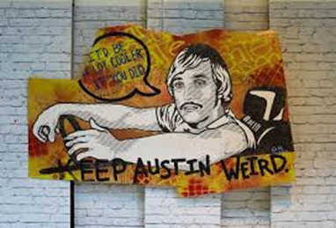
The Team
Joydeep Ghosh – DevOps Architect
John Denton – Bot Developer
Nathan Southerland – Developer
Jeffrey Natiuk – Developer
Srujana Nekkanti – SDET
Mustafa Akhterul – Cloud Architect
Jeff Erp – ScrumMaster

Slide 4
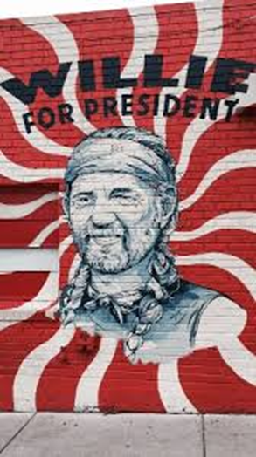
Product Overview – The Concept
The goal was to create an expert assistant to help a user select a product based on natural interactions which are designed to allow product selection based on the specific needs of the user.
These interactions could occur on a variety of platforms - from a website or app to Cortana, Skype, Teams, Office 365 mail, Slack, Facebook Messenger and more!

Slide 5
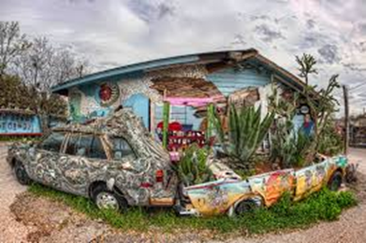
Product Overview – More Concepts
Product would allow a human expert to script the questions and build a decision tree to do product selection based on the user’s answers to the questions.
Questions are scripted through the Microsoft Bot Framework.
Products can be anything from a finished product to a selection of components that would allow a user to build their own product (for example, a computer).

Slide 6
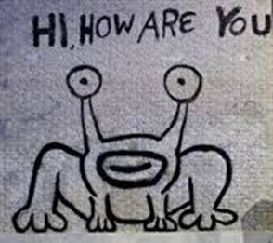
The Technology
Microsoft BotFramework & LUIS API
Code behind this is C# ASP.NET Web API
Visual Studio IDE for C# projects
Bot API
Data Service API
Data Modeling
Data Repo – Azure Storage
Utilities – Recommendation calculation matrix & Resource lookup via Azure Search (future)
Microsoft Tests – Unit & Integration Testing
Specs – SpecFlow BDD tool used to capture main usage specifications for bot
Visual Studio Online for git repo and Scrum Story Boards

Slide 7
The Technology
Microsoft Azure
Backend Database – DocumentDB Table Storage
Web Apps for Web API deployment
Application Insights
Selenium
Automated UI testing (web based channels)
Chat Channels
Skype
Slack
TeamCity and Octopus Deploy for CI/CD process

Slide 8

CI/CD
Joydeep – add your bullet points here!

Slide 9

Testing and Automation
Srujana – add your bullet points here! Of course, you’ll focus more on what you learned than what you did! ☺

Slide 10
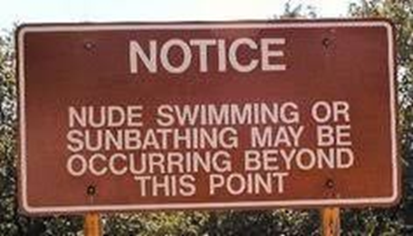
Agile (Scrum)
I’ll add some stuff here

Slide 11
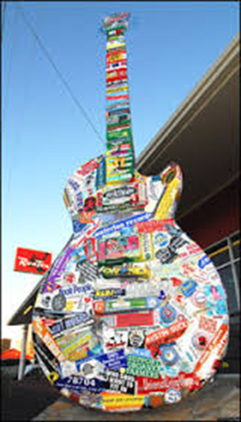
Agile (Scrum)
More agile stuff here

Slide 12
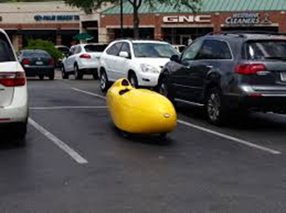
In Retrospect (Lessons Learned)
Our retrospective

Slide 13
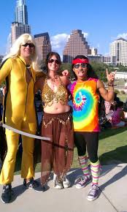
Let’s Take a Look!
Product demonstration by John Denton

Slide 14
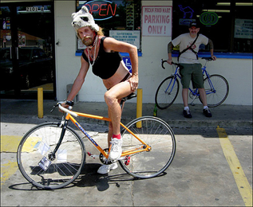
Wrapping it up
Full product would include:
an agent to “shop” the Internet for best prices
a UI to make it easier for a human expert to add/modify questions and product recommendations
Expand to multiple user interaction platforms

Slide 15


